Slide 1
G2G
Good Times To Go!!!
A Rutgers data Science Boot Camp Project By: PRAGATI MEHTA, Joe Marchell, Roderick jean, and Raymond chan

Slide 2
Team InTRODUCTION
Joe Marshall - Documentation, Historical Data Trend Analysis & Data exploration
Pragati Mehta – Data analysis, Cleaning, Exploration, Coding & Testing
Raymond Chan –Data analysis, Exploration, Coding & Testing
Roderick Jean – Documentation & Data analysis (Activities)

Slide 3

We have a problem !!!
In today’s world we are fighting a never ending battle against boredom !!
A paradox that we have boredom but no time to do all the research and decide upon the activities to do or places to go based on weather or time available !!
How often do we find ourselves sitting at home on a rainy day bored because we can’t think of anything to do ?
How often do we let a beautiful summer day pass by because we had no plan for fun ?
How often do we send the “I’m bored” text or the “all I do is work “ text?
How often do we let the day off from work pass us by?
This Photo by Unknown Author is licensed under CC BY-NC-ND
This Photo by Unknown Author is licensed under CC BY-NC-ND

Slide 4

WELL NO MORE !!
The G2G system provides weather conditions and recommended activities based on the weather and time.
No more sitting at home on a rainy day!
No more missing summer days!
No more sad text!
No more wasted days off !
Finally a way to spend leisure time the most efficiently!

Slide 5

free time into fun time !!
The process requires the user to input local city and state of their choice location.
The app will use the input city and state to provide weather conditions.
Based on said weather conditions and the time available, the app will determine indoors or outdoors activities available.
Within each Indoors and Outdoors activities are different recommendations.
It will also demonstrate whether the place of activity is Open or Closed
This Photo by Unknown Author is licensed under CC BY-SA

Slide 6
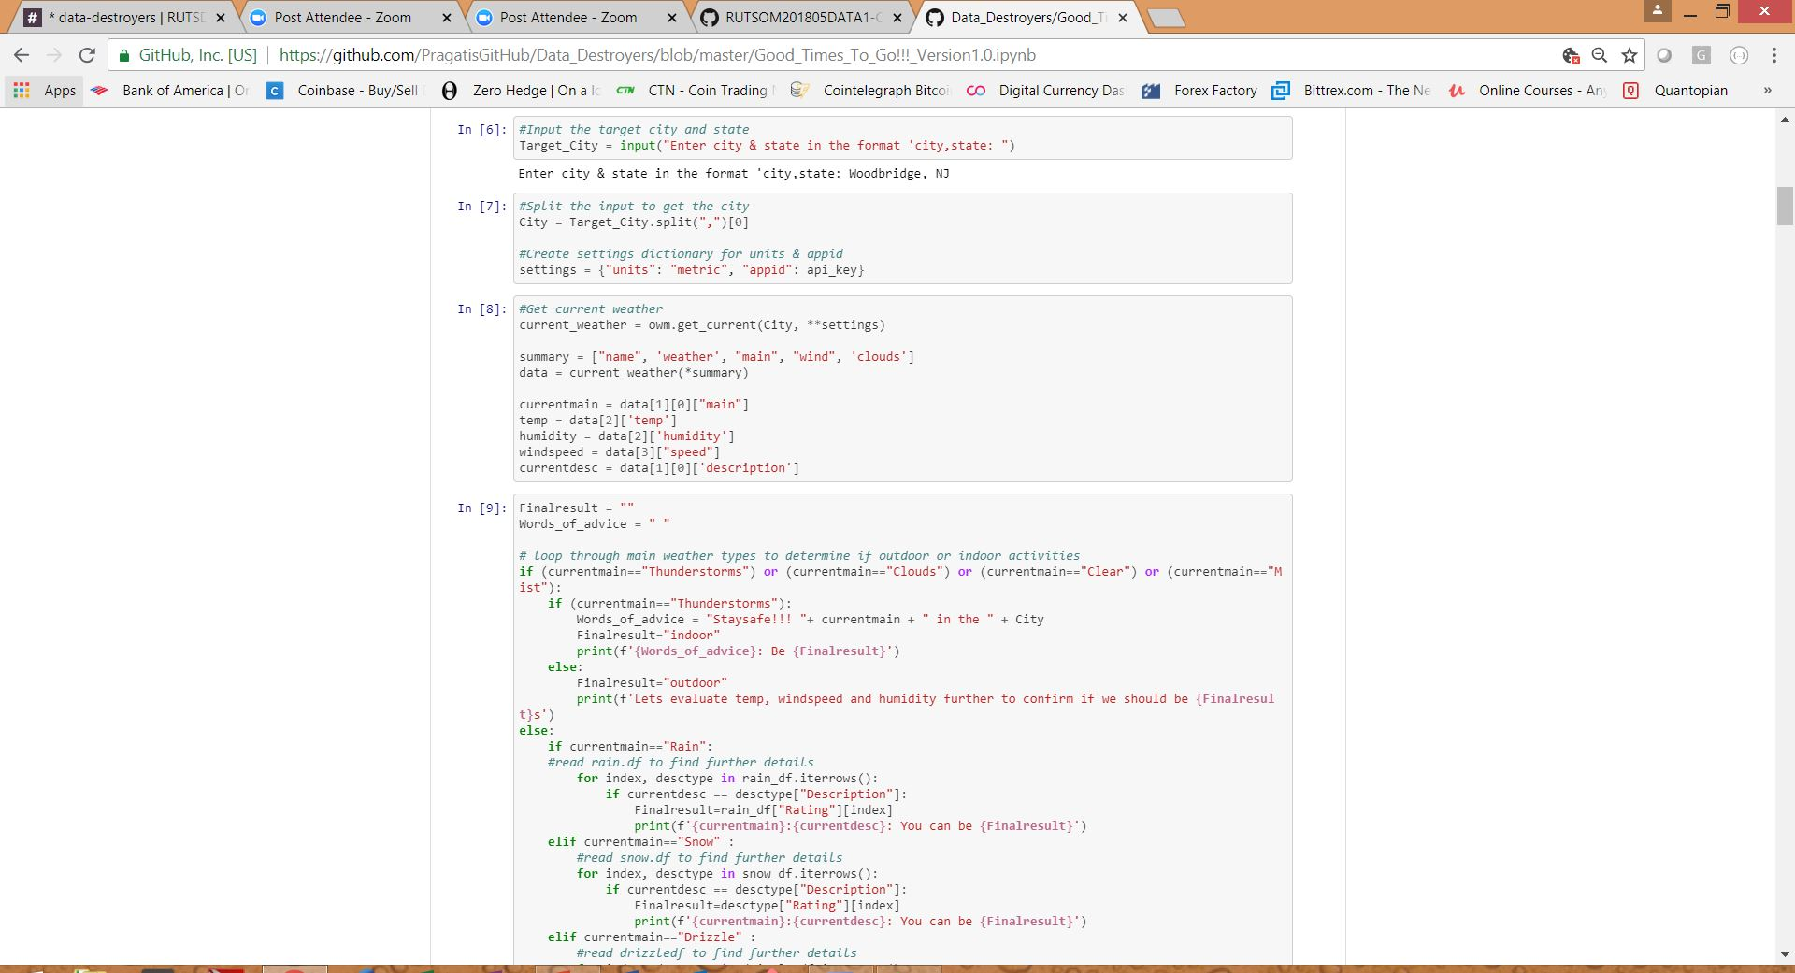
example Input
One will input their city and state into the app. This will run a request for the open weather map wrapper based on the location. This responds with the weather types, weather description, humidity, temperature, and windspeed.

Slide 7
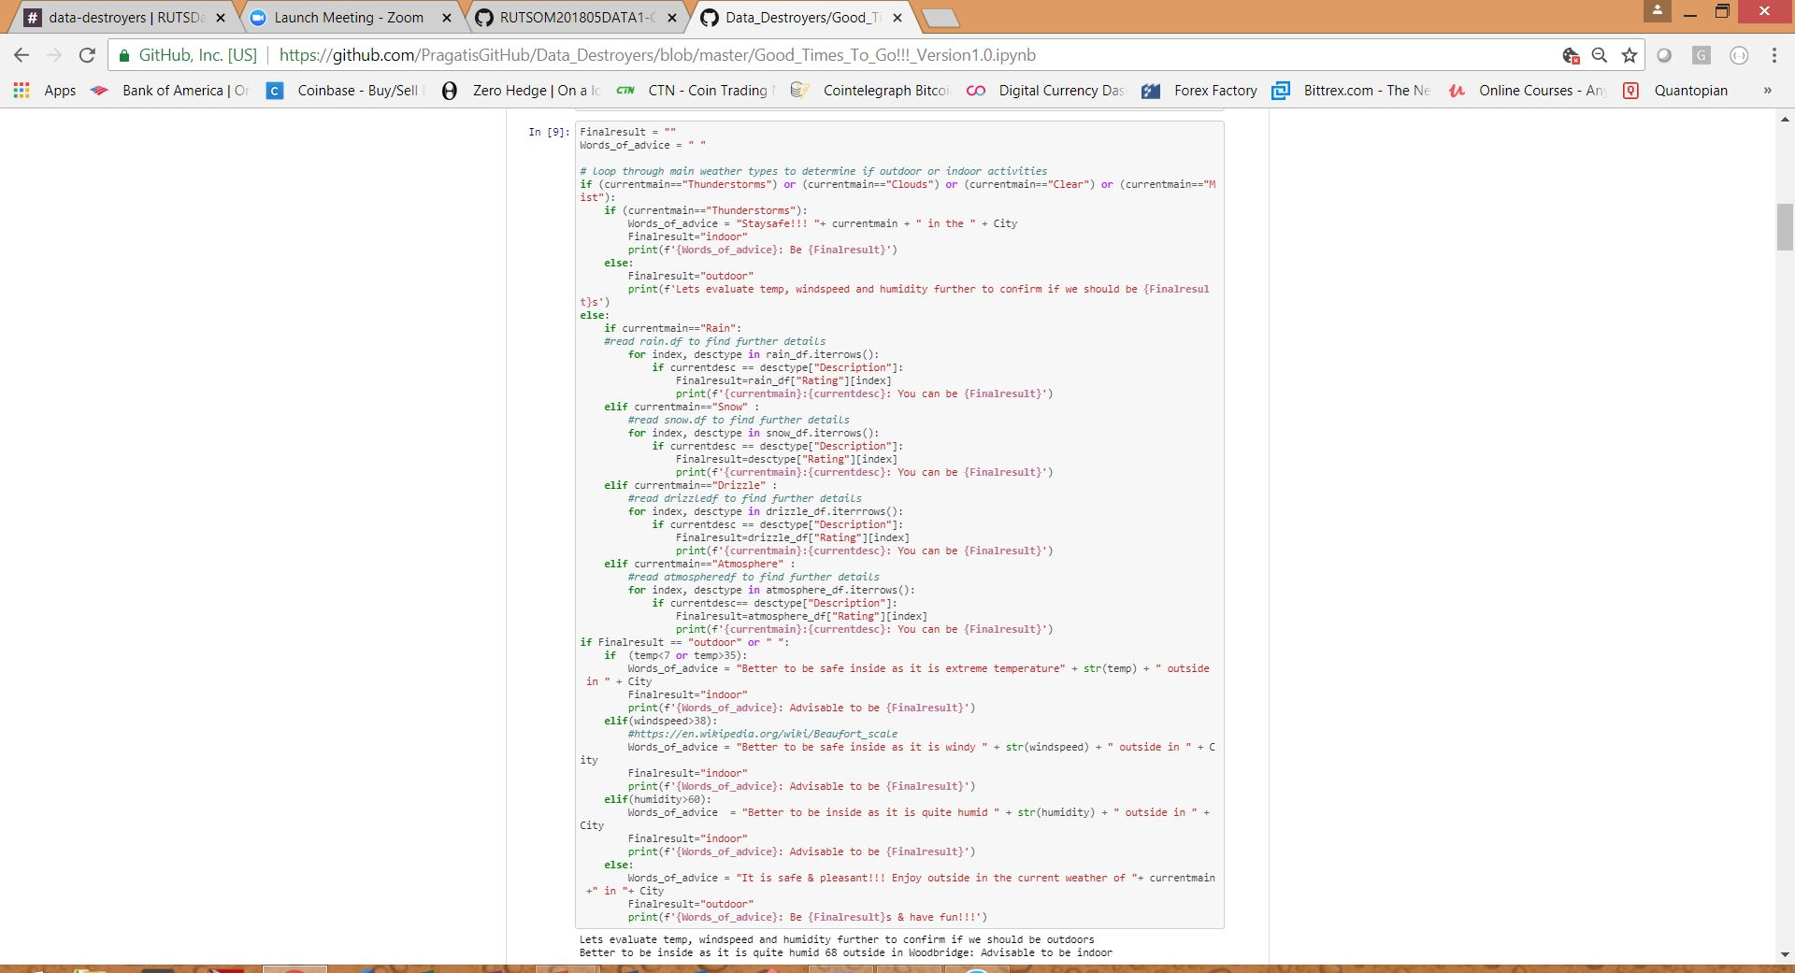
Looping through weather
We proceeded to declare which main weather types deserve to be Indoor or Outdoor. Some instances required additional thought when you consider that a very light rain may not deter people from outdoor activities. Or a clear day could be too hot or humid. Finally we output the recommendation based on the local weather.

Slide 8
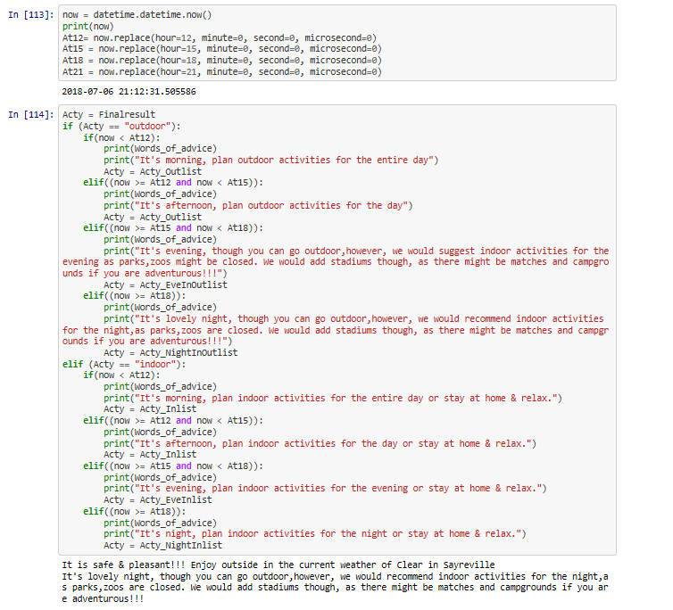
Activities by times
This section of code shows the activities that are recommended or available based on the time of day. Since time of day affects both the current weather and the activity or business hours of operation.

Slide 9
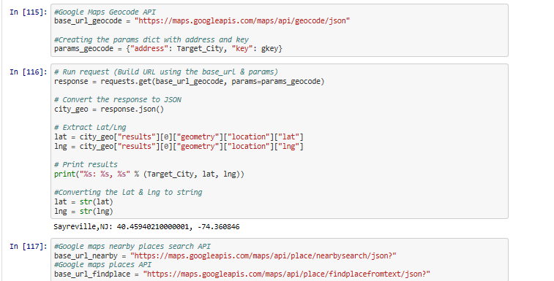
Geocode & location
This section will run a request for the Google Maps API based on the location. This responds with the latitude and longitude needed to proceed with nearby search and local activities.

Slide 10
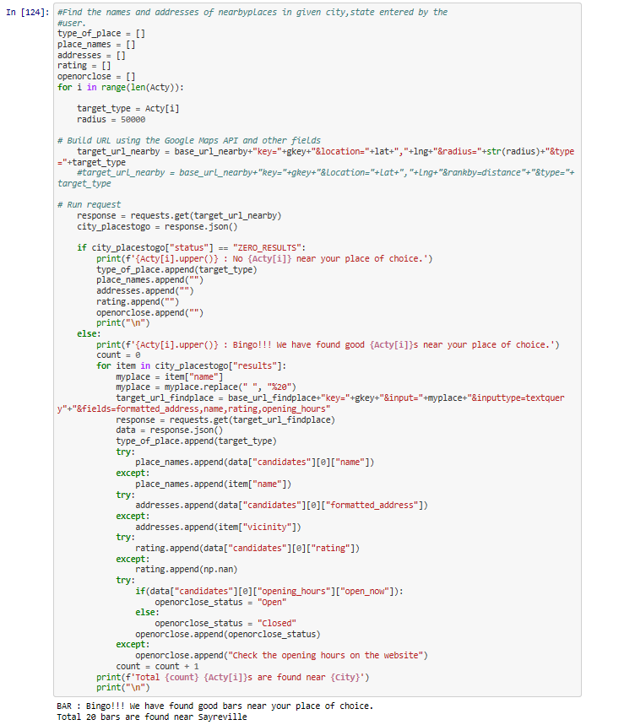
Finding nearby places
In this section of code, we searched the “Indoor” or “Outdoor” activities found on Google Maps whether they’re available in the given radius.

Slide 11
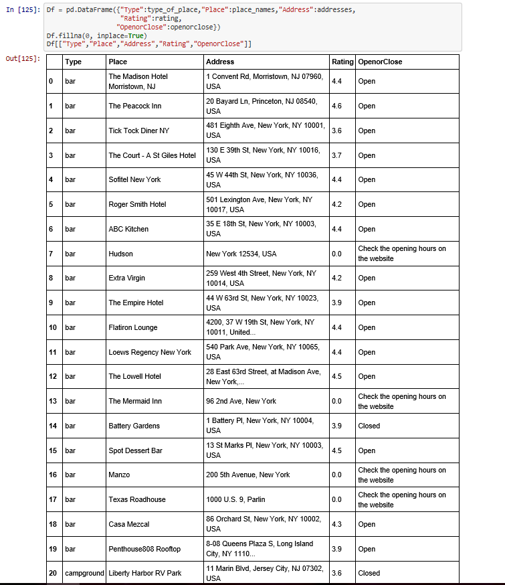
Activity results
The combination of weather, inputted place, and activities are all calculated and concluded in the data frame with choices for the user to select. To help in the decision making process we provided the rating and the Open/Close status.

Slide 12
Challenges
Keeping the API calls to the minimum.
Exceeding the API usage limit per second.
Dealing with no rows while plotting the graph.
While plotting plot distortion as the name of the places are too long.

Slide 13
Data Clean Up
Incomplete or no results from the APIs.
No google rating available for many places.
Some places not returned when I filter by type? (It's possible that the place you are looking for has not yet been categorized. All places are categorized as the generic type "establishment" until Google has enough data about a place to categorize it as one of the supported place types.

Slide 14
Data exploration
While sifting through the activities we had to create a CSV file that already identified the usual Outdoor/Indoor activities. Further, we had to create CSV files specific to time.
Going through the weather data, we realized a situation could arise where a person may not want to do an Outdoor activity even though it is sunny or a clear sky. To remedy this, we set limitations on all weather to include certain temperature maximum and minimum ranges. Also we included a limitation on humidity and windspeed.
An additional problem that we faced was a lack of users to yield data from. To rectify this, we sought Kaggle and other sites for data regarding leisure activities based on Age groups. From this, we can infer which age demographic will be pursuing certain activities. We can further examine this through the lens of seasonality on our roadmap.

Slide 15
THE APPLICATION & PRACTICALITY OF G2G
The following slides will discuss how the app can be used by both users and business owners in order to take full advantage of the exciting activities their local economy provides.

Slide 16
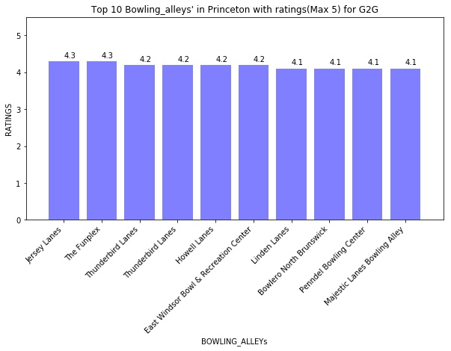
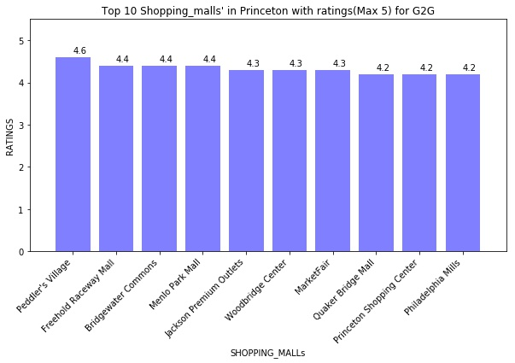
Princeton Practicality example
In our Princeton example, our app shows ratings based on a particular activity in the area. Local businesses can use this to determine the level of competition they’re facing. Furthermore, they can use our app to see if their place of business is a recommended activity based on the weather of the day and plan accordingly.

Slide 17
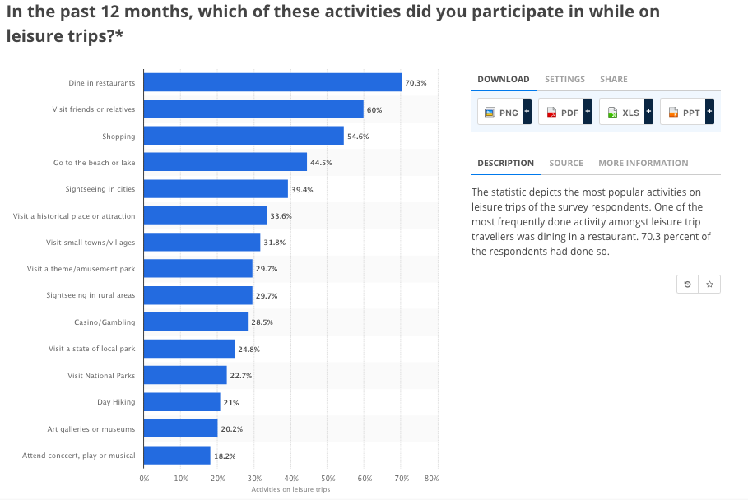
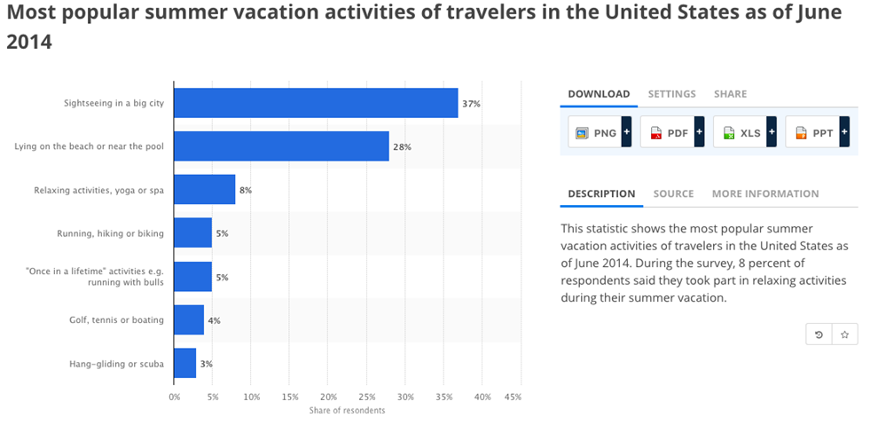
Leisure trips
APPLICATION ON VACATION
The statistics depict the most popular activities on leisure/vacation trips of the survey respondents.
On our roadmap we look to include such statistics as an additional way to provide suggestions in a given place.
Conversely, if a activity is recommended too much in a tourist area, then we can suggest a less visited activity in order to avoid tourist congestion for the user.
Source -https://www.statista.com/statistics/186252/most-popular-activities-on-leisure-trips-in-the-us/

Slide 18
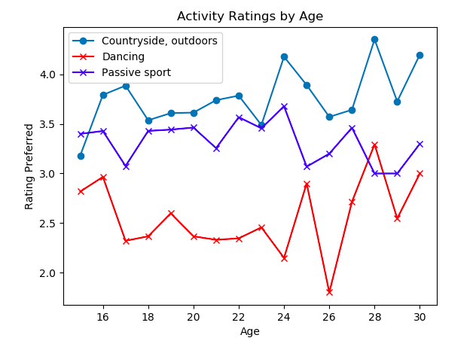
Activities ranked through the age groups
This graph demonstrates which age demographic would most likely attended some sample activities that can be found through our app.
As we can see outdoor activities are more highly valued than indoor activity such as dancing.
Source -https://www.kaggle.com/c/walmart-recruiting-sales-in-stormy-weather/data

Slide 19
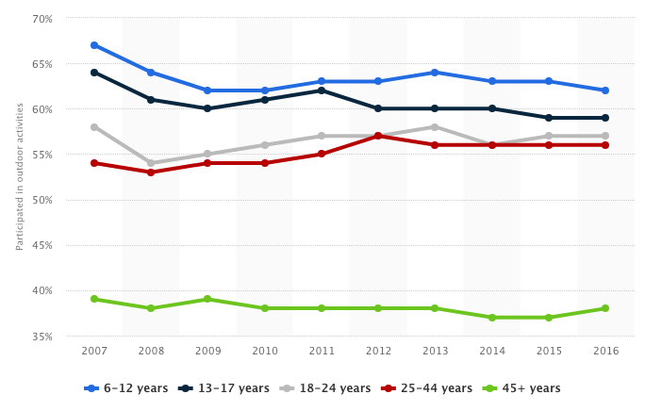
Participation of outdoor activities based on age
In this graph we see the likely age demographic for outdoor activities. Towns and businesses can plan accordingly with outdoor festivals, concerts, food truck fests and the like.
Source - https://www.statista.com/statistics/190083/outdoor-activities-participation-rate-by-age-group-in-the-us/

